Slide 1

Instagram Reels Analysis
Burak Semi Yakar 30917

Slide 2

My data set
I used a dataset from my Instagram page, where I posted reels focused on cartoons and animations.

Slide 3
My Hypothesis
Both the posting time and the content parameters (caption length, video length, and hashtag usage) significantly influence engagement metrics (e.g., Instagram Plays, Likes, etc.).

Slide 4
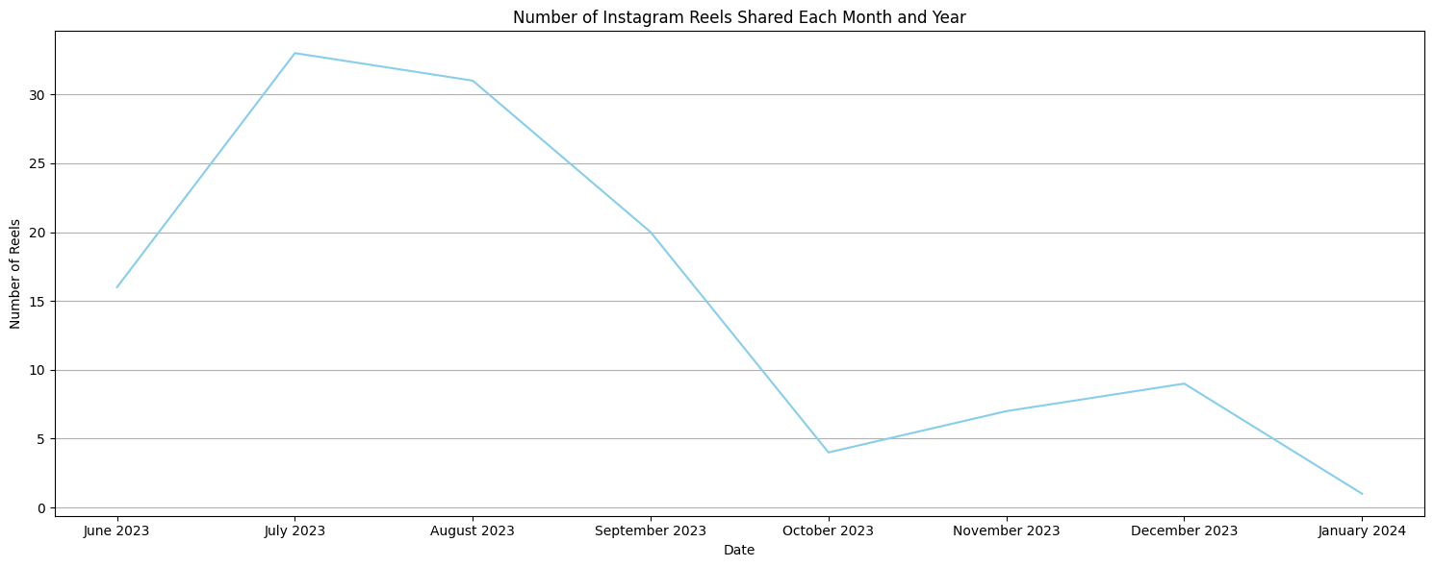
Number of Reels Shared by Month and Year
First, I analyzed the number of reels shared by month and year. However, since I shared reels during only a few months, I decided it would be better to analyze the data by day of the week instead.

Slide 5
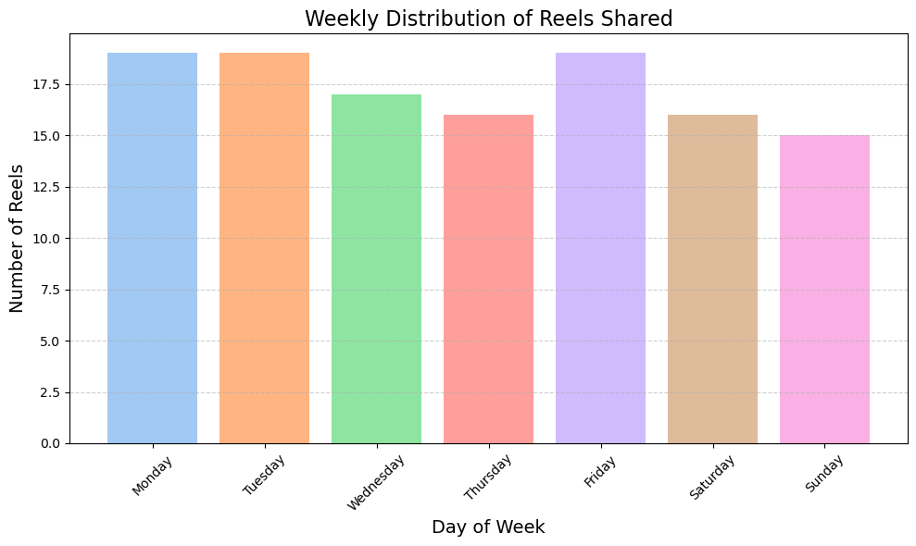
Weekly distribution of Reels Shared
The number of reels shared appears to be roughly the same across different days of the week.

Slide 6
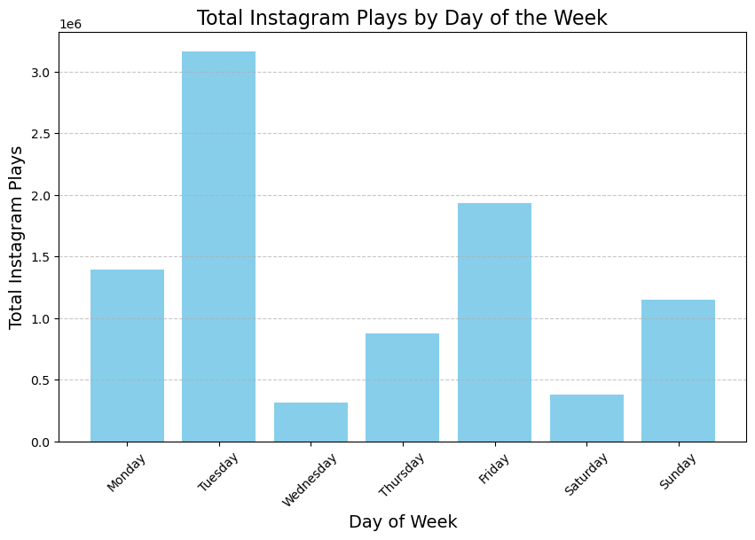
Total Instagram plays by day
The total Instagram plays vary significantly by day of the week, with Tuesday and Friday receiving the highest engagement, while Wednesday and Saturday have the lowest.

Slide 7
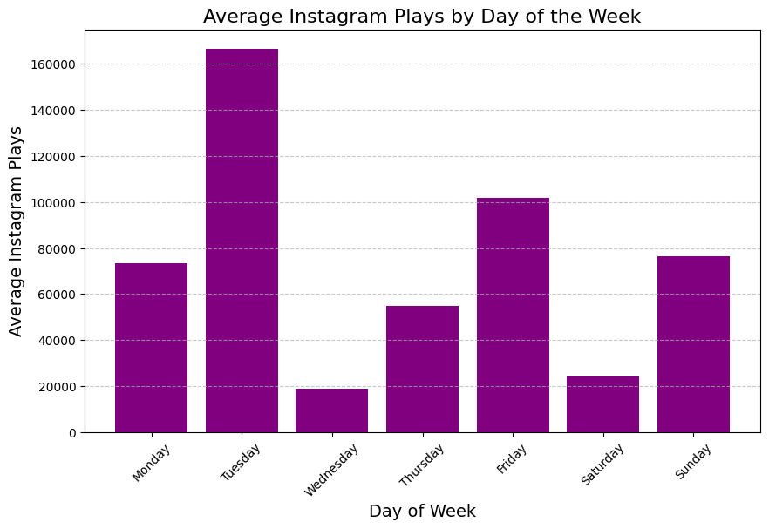
average Instagram plays by day
The average Instagram plays also similar to total plays vary significantly by day of the week, with Tuesday and Friday receiving the highest engagement, while Wednesday and Saturday have the lowest.

Slide 8
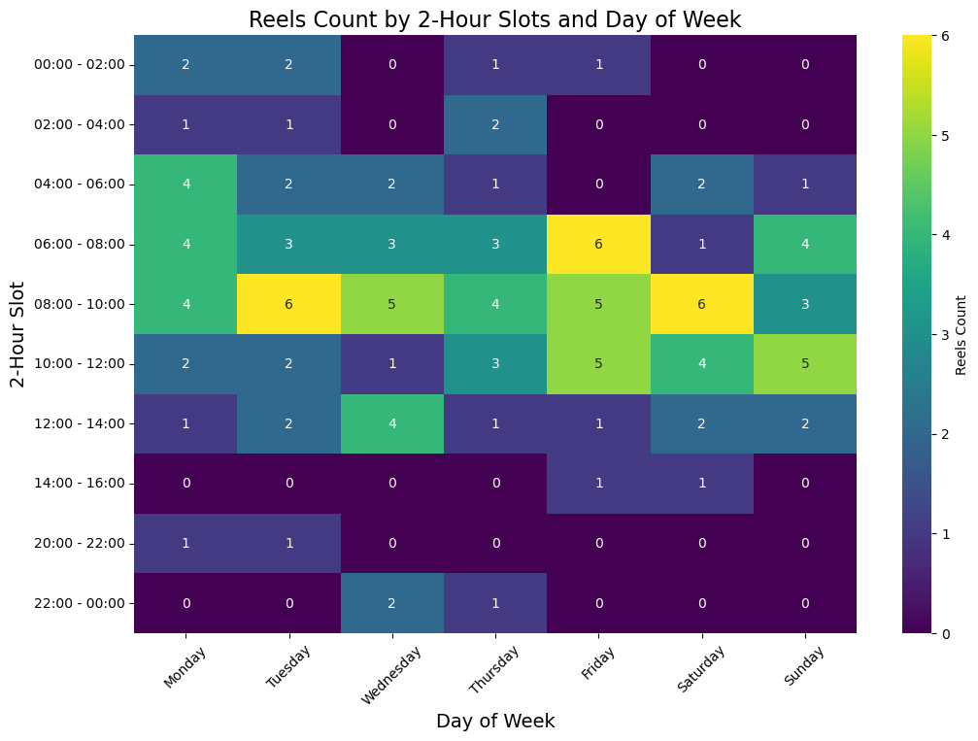
Reels count by day and 2-hour slot
The heatmap shows that most reels are shared during the morning hours 06:00-10:00 on various days, with peak activity on Tuesday and Friday mornings.

Slide 9
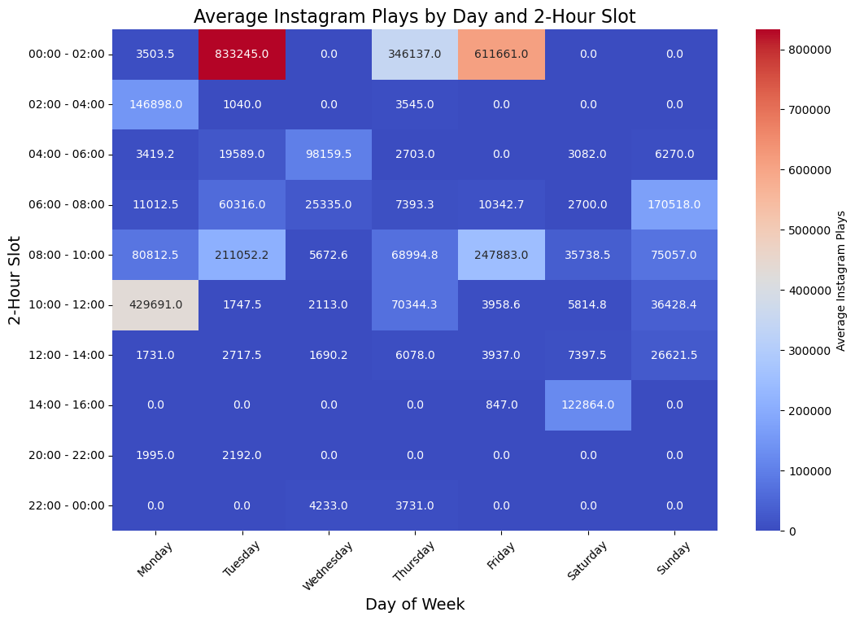
Average instagram plays by day and 2-hour slot
The heatmap illustrates that the highest average Instagram Plays occur during the late-night hours 00:00-02:00 on Tuesday, with another significant peak on Friday mornings 08:00-10:00. These findings suggest specific time slots with higher engagement rates.

Slide 10
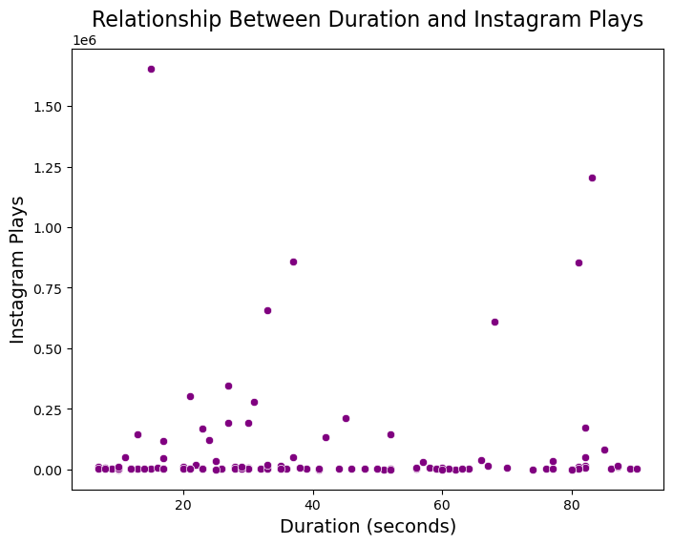
Relationship between duration and instagram plays
The scatter plot shows no clear correlation between video duration and Instagram Plays. While some shorter videos received significantly high plays, longer durations do not consistently result in higher engagement. This suggests that duration alone may not be a key factor driving performance

Slide 11
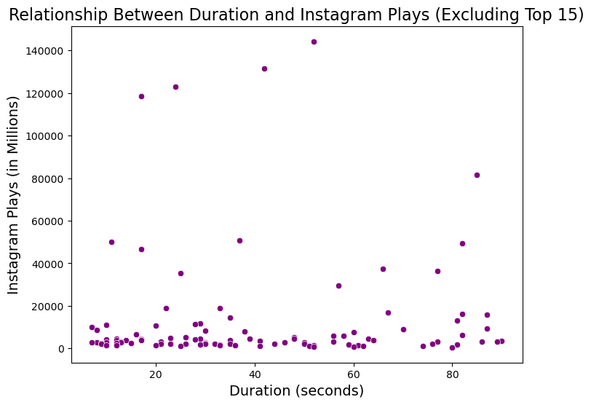
duration and instagram plays (excluding top 15)
After removing the top 15 videos with the highest Instagram Plays, the scatter plot offers a more focused view. However, even without these outliers, there is still no consistent trend between video duration and engagement, reinforcing the idea that other elements, such as content quality or timing, are likely more influential.

Slide 12
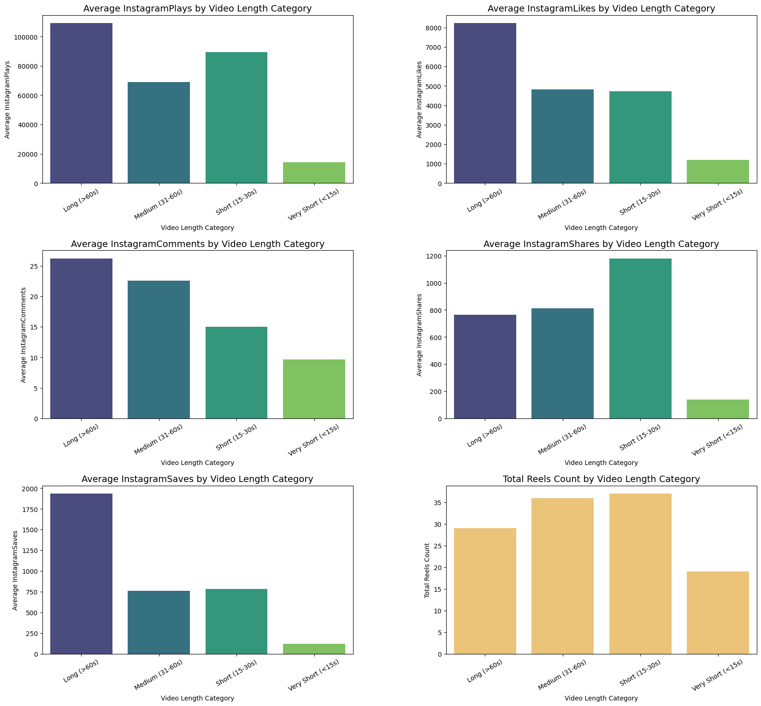
Average metrics by video length
While longer videos generally drive higher plays, likes, comments, and saves, shorter videos excel in shares. The total count highlights a preference for producing shorter content, but balancing duration with engagement goals could optimize performance.

Slide 13
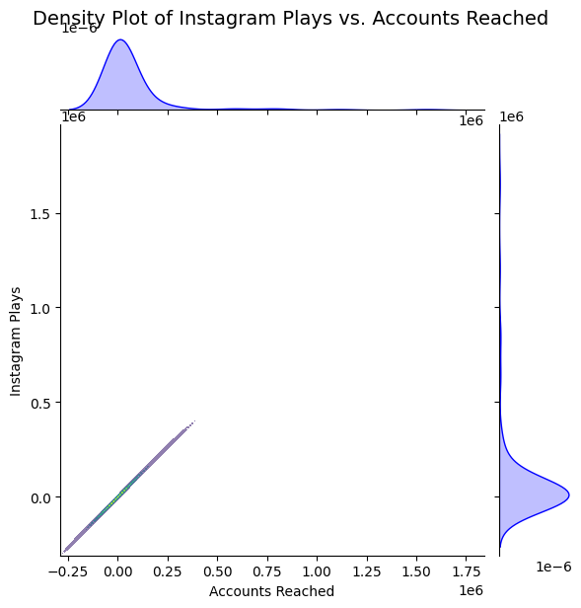
DENSITY PLOT OF PLAYS AND ACCOUNTS REACHED
The density plot indicates a strong positive relationship between Instagram Plays and Accounts Reached, as shown by the diagonal clustering of points. However, the presence of extreme outliers skews the distributions, with significant peaks at higher values for both metric. These outliers likely dominate the overall trend, masking more subtle variations in the data

Slide 14
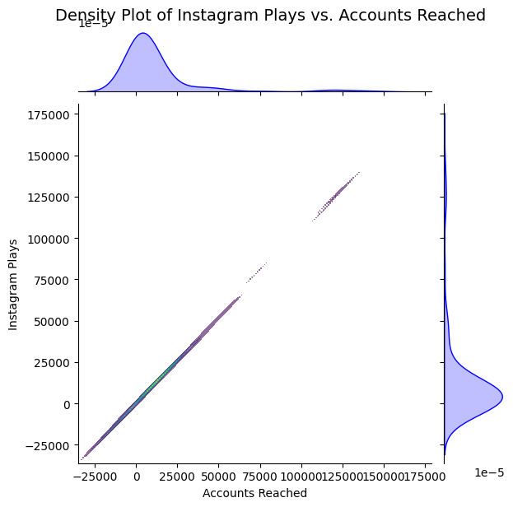
DENSITY PLOT OF PLAYS AND ACCOUNTS REACHED WITHOUT OUTLIERS
After removing outliers, the relationship between Instagram Plays and Accounts Reached becomes clearer and more linear. The distributions are less skewed, indicating a more uniform dataset. This cleaned version better reflects typical engagement patterns, showing that as Accounts Reached increases, Instagram Plays also increase proportionally without distortion from extreme cases.

Slide 15
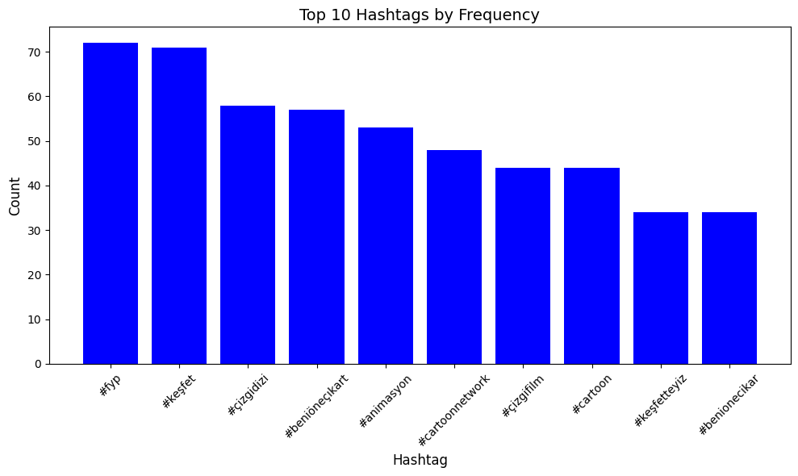
the most used ten hashtags
The most used 10 hashtags and their counts.

Slide 16
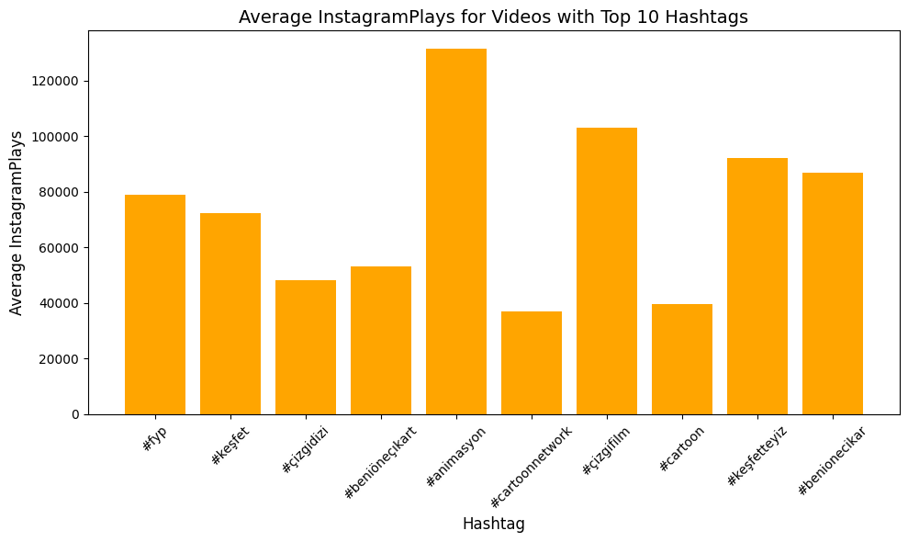
AVERAGE PLAYS FOR VİDEOS WITH the most used ten hashtags
Videos with the hashtag animasyon achieve the highest average Instagram Plays, significantly outperforming others.
Hashtags such as fyp, keşfet, and çizgifilm also show strong performance in terms of average plays.
Lower-performing hashtags include cartoon and çizgidizi.

Slide 17
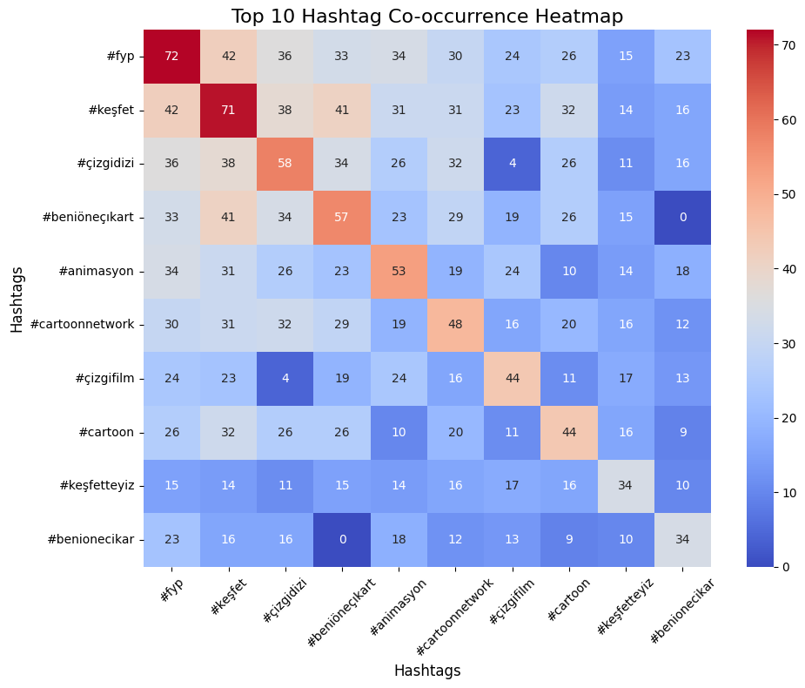
the most used ten hashtags CO-OCCURANCE HEATMAP
This heatmap reveals how frequently the top 10 hashtags are used together in the same post.
High co-occurrence is observed between hashtags like fyp and keşfet, indicating that these are commonly paired.

Slide 18
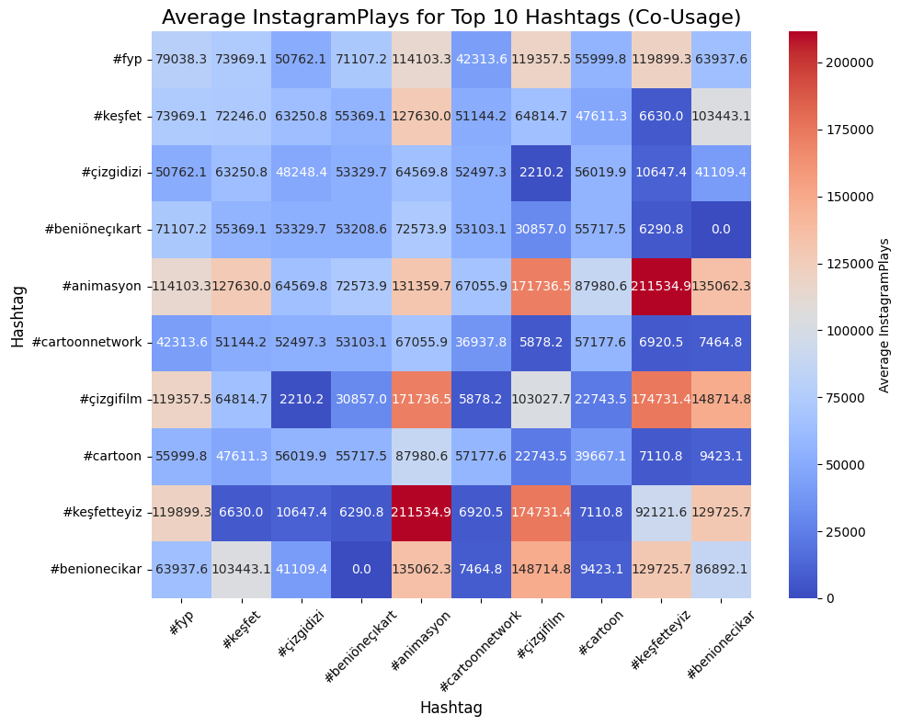
AV. PLAYS FOR VIDEOS WITH the most used ten hashtags CO-OCCURANCE HEATMAP
This heatmap displays the average number of Instagram Plays for posts using combinations of two hashtags.
Some hashtag pairs, such as animasyon and keşfetteyiz, achieve significantly higher average plays, suggesting these combinations might be particularly effective for engagement.

Slide 19
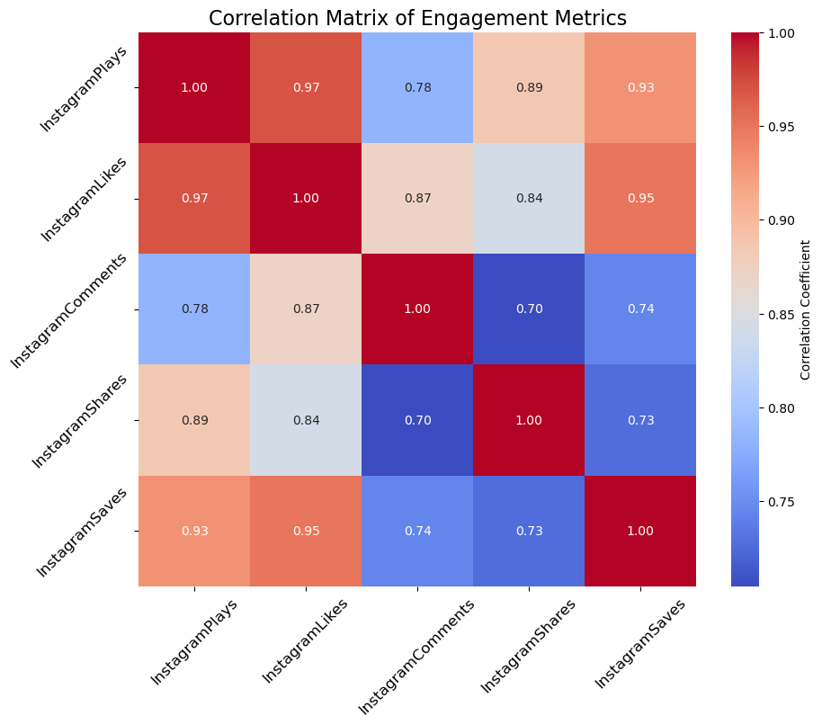
Correlation matrix of engagement metrics
The correlation matrix shows strong positive relationships between Instagram Plays, Likes (0.97), and Saves (0.93), indicating that these metrics often increase together.
Comments and Shares show weaker correlations with other metrics, particularly Comments with Plays (0.78) and Shares (0.70).
Overall, Plays, Likes, and Saves are closely linked, while Comments and Shares may require distinct strategies for improvement.

Slide 20
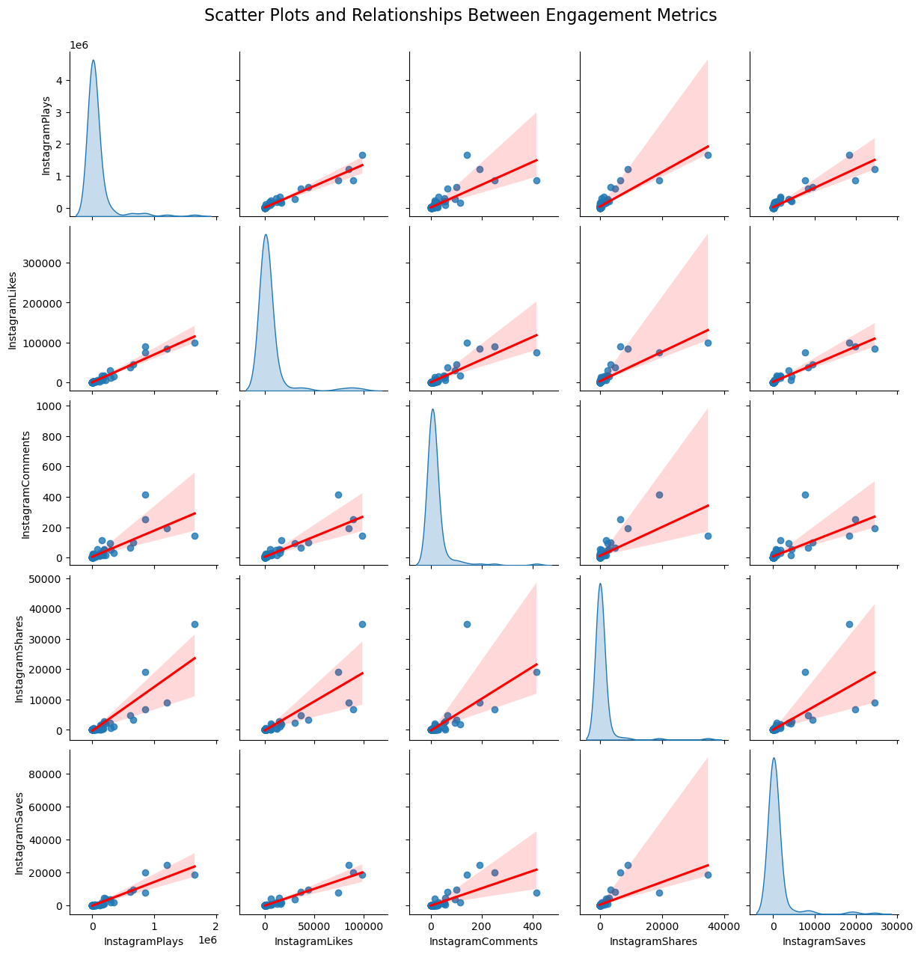
SCATTER PLOTS AND RELATIONSHIP of engagement metrics
This plot shows strong positive correlations between Plays, Likes, and Saves, while Comments and Shares have weaker relationships with other metrics. The density plots indicate that metrics like Plays are skewed, with a few posts driving most of the engagement.

Slide 21
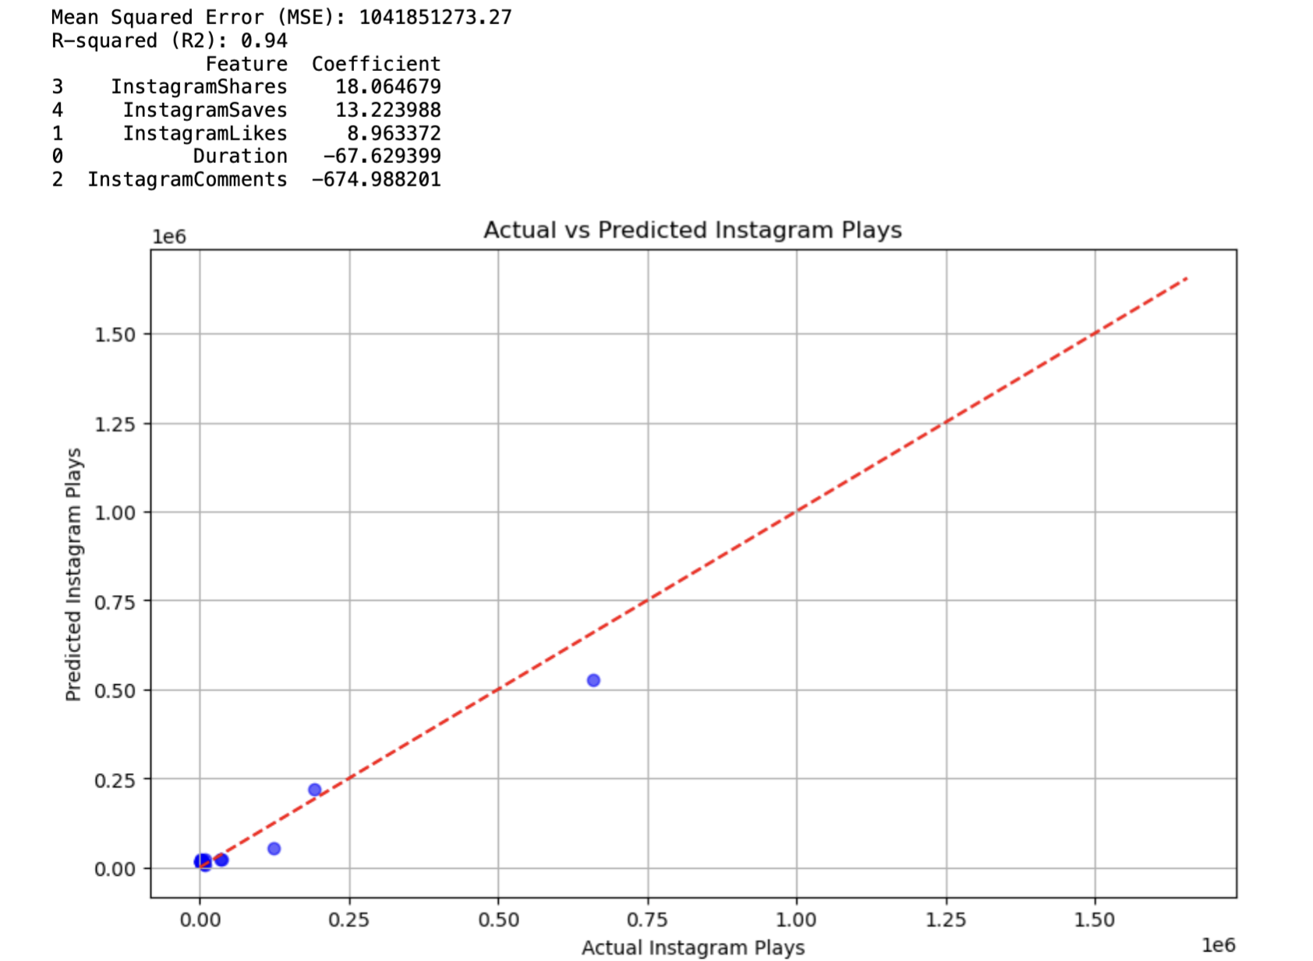
Actual vs predicted Instagram plays
Observation: The plot shows a general trend aligning predicted and actual Instagram Plays along the red line (perfect prediction). However, the spread of points makes it difficult to evaluate the model's performance effectively.
Limitations: The scale and distribution of the data lack clarity, making it hard to identify any systematic errors or outliers.

Slide 22
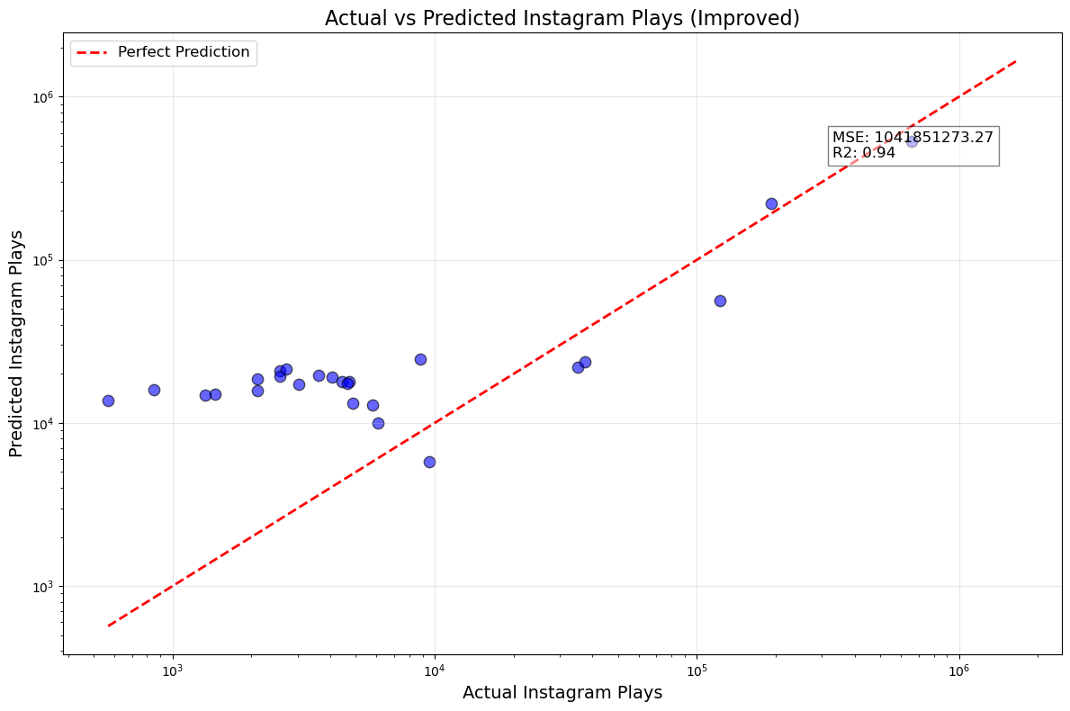
Actual vs predicted Instagram plays (improved)
Observation: The improved plot uses a logarithmic scale, offering better visualization of the data distribution across a broader range of values. The high R-squared value (0.94) demonstrates a strong model fit.
Insights: The log scale highlights deviations between actual and predicted values more clearly, providing actionable insights into where the model might underperform.

Slide 23
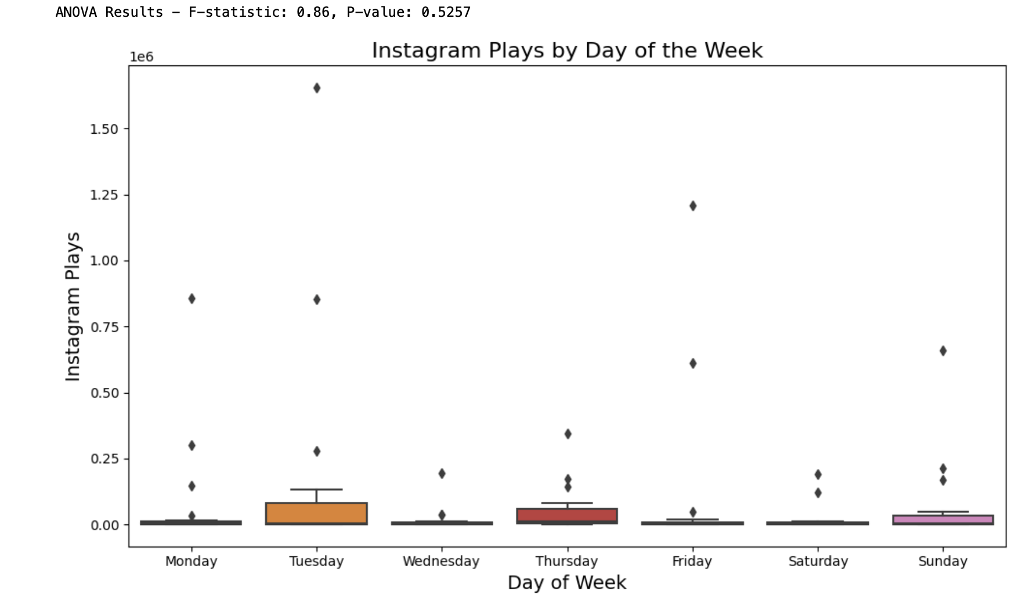
Anova - Instagram plays by day of week
F-statistic: 0.86
P-value: 0.5257
The analysis indicates no statistically significant difference in Instagram Plays across the days of the week when outliers are included. The large variability caused by extreme outliers, especially on certain days like Tuesday and Thursday, skews the results. This makes it challenging to discern the actual distribution and patterns in the data.

Slide 24
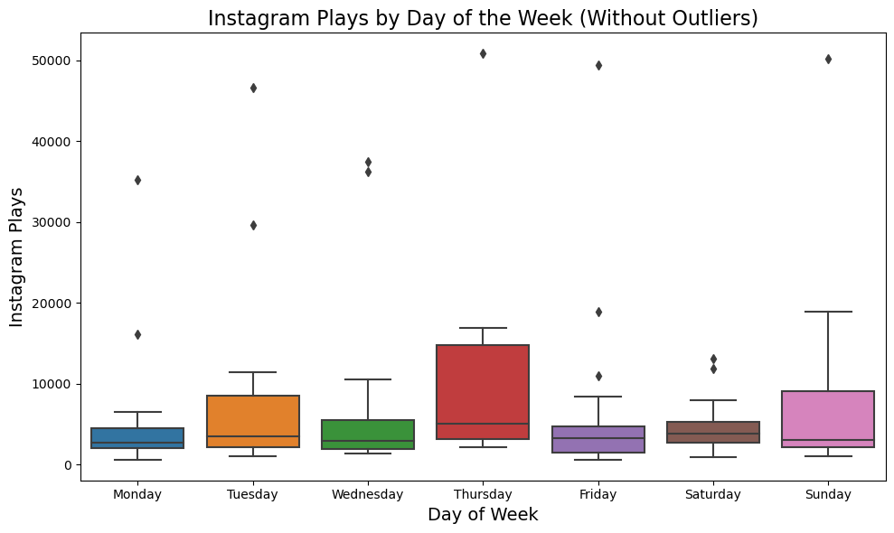
Anova - Instagram plays by day of week without top 15 outlıers
F-statistic: 0.44
P-value: 0.8475
After removing the top 15 outliers, the F-statistic and p-value indicate an even weaker association between the day of the week and Instagram Plays. The exclusion of extreme values reduces variability but does not reveal significant differences among the groups. This suggests that the day of the week likely has no meaningful impact on engagement.

Slide 25
Conclusion
The hypothesis is partially supported. While content parameters like hashtags, video length and day of week have significant effects on engagement, the impact of posting time (hour) cannot be determined conclusively due to most posts being concentrated in the morning hours, limiting the analysis. Strategies focusing on content quality and hashtag optimization remain more impactful.

Slide 26
Thank you for your time

